Slide 1
dIY aSSET MaNAGEMENT
For Public UTILITIES
J.B. Churchill Garrett County, MD
Planning & Land Management
Notes:
I don’t actually work in Public Utilitles … I work for Garrett County in Planning & Land Management.
We are a small county (population-wise) of about 30K.
I worked for a natural gas company (EQT) in Clarksburg, WV for about 10 months prior to this
I worked in Natural Resources Science for several years prior to that AL & WVU / NRAC and USGS through IAP World Services.

Slide 2
Justification
The project was initially a request for a map.
Starting out I was going to just digitize the Business Parks.
I was surprised that we didn’t have these data layers already.
I feel that having these layers will be beneficial to DPU.
Notes:
So the County Administrator wanted to see a map of public water and sewer in the County Business Parks. WE DON’T HAVE THAT!!!
So I decided I could create it. I obtained some CAD layers (minimal) and Scans of proposed water/sewer CAD drawings. I see the VALUE in having these layers (and hopefully the department (DPU) will too).

Slide 3
Planning – Natural Planning Model
1. Defining Purpose and Principles
Create enough Point and Line Data to map the business parks.
Provide a baseline layer for DPU to improve upon.
2. Outcome Visioning
Make it easier to locate and look up information about Water/Sewer infrastructure.
Use to improve existing asset management and maintenance protocols.
Future data conflation process with GPS => better Miss Utility type locations.
Notes:
Mapping the business parks was the original purpose but I thought that creating a baseline dataset was even more important.
Outcomes include easier access to information (charts, graphs, statistics “Oh My”!) … process improvement in asset management and … in the future we can GPS assets and more correctly locate them in the GIS which allows us to locate them in the field without even visiting the site (in some cases).
I remember our guys at EQT being able to stay in the office and provide guidance for 811/Miss Utility calls without even going in the field.

Slide 4
Planning – Natural Planning Model
3. Brainstorming
Meetings & Phone Calls with Head of DPU (Pat)
Schema from ESRI PU Data Model & from what was symbolized on CAD Drawings.
4. Organizing
Making notes in OneNote and on my whiteboard (schema document).
5. Identifying Next Actions
Obtain and scan paper documents (or CAD data where available).
Georeference documents.
Digitize and Attribute!!!
Notes:
Talked with Pat a few times about the idea I was hatching. I borrowed some from the Public Utilities Data Model but really only used what was needed (no GUIDs or anything).
I’ll show a photo of my whiteboard
Next actions is the last phase of Planning and is a sort of transition into starting the project.

Slide 5
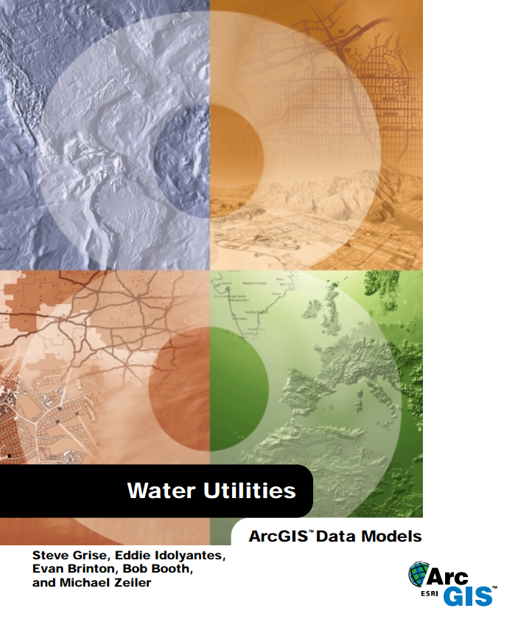
Needs Evaluation
In the Brainstorming phase (phone calls and meetings), we determined what was needed for the project.
Water Utilities Data Model
Notes:
One really good recommendation I got (Mary from Frederick County) when I mentioned that we were starting to do this, was to check out the ArcGIS Public Utilities Data Model. There is this huge PDF (free) online.
It is complex so rather than start with their template and delete fields we will never use, we built it from scratch using the fields we knew we could use.
We did not use CASE tools or a schema creation wizard but those do look like interesting tools to use.

Slide 6
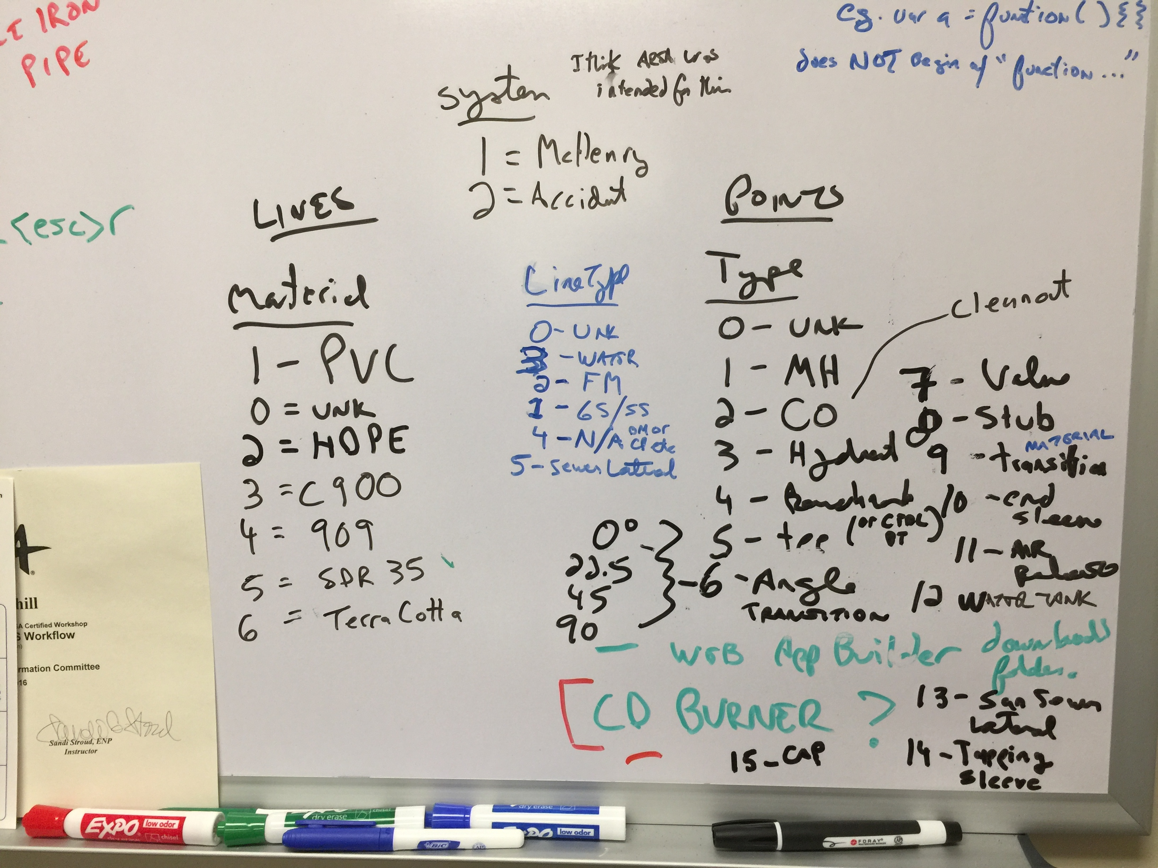
The Schema Document
Notes:
The schema document lived (for a while) on my whiteboard. I figured I’d better get a photo of it. I’m working on writing up this schema in a separate Power Point file.

Slide 7
Points
Lines
OBJECTID ESRI Object ID
Shape ESRI Geometry ID
Y Coordinates
X
FILE_ filename of drawing
COMMENT all-purpose comment
SOURCE Digitized (for now)
Type feature type (CVD)
LineType water / sewer (CVD)
Angle only for Type = 6 (angle)
Sheet CAD drawing number
UPDATED Editor Tracking Fields
MODIFIEDBY
CREATED
CREATEDBY
SYSTEM which area (CVD)
diameter inches (for pipe features)
OBJECTID ESRI Object ID
Shape ESRI Geometry
Shape.STLength() Double Id
Material Coordinates
CAD_Len feet (where known)
Comment all-purpose comment
diameter inches (where known)
Sheet CAD drawing number
PDFSCAN filename of drawing
SOURCE Digitized (for now)
LineType water / sewer (CVD)
Angle only for Type = 6 (angle)
UPDATED Editor Tracking Fields
MODIFIEDBY
CREATED
CREATEDBY
SYSTEM which area (CVD)
Notes:
We basically just have 2 feature classes (one called points and the other called lines). Type is a good field to symbolize points with to show features such as manholes, valves, angles, hydrants, sleeves, caps etc. differently. I typically just use LineType for the lines to show whether they are water, gravity sewer, forced main, or laterals etc.

Slide 8
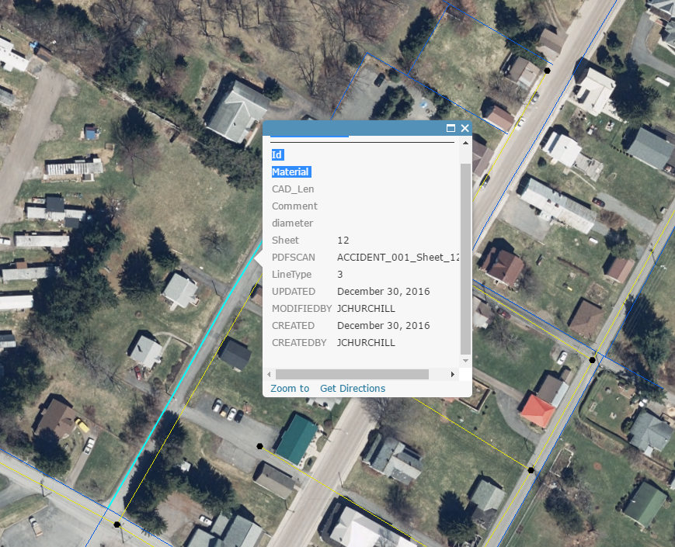
Coded Value Domains
Notes:
We are waiting to implement the CVDs with the idea that more values may be added. The downside of waiting is that in our webmaps and apps, it isn’t apparent to anyone that LineType of 3 is a water line (except that it is a blue line).

Slide 9
IMPLEMENTATION PHASE
1. Georeferencing
Scanning Maps or Acquiring PDF documents
Using the “Georeferencing” Toolbar to create georeferenced tif images.
2. Digitizing
Creating points & lines in the Enterprise database from the tif images.
3. Editing (Schema)
There is lots of back and forth on values for Coded Value Domains (new values added etc.)
Easy for a team of one!
Notes:
We had some of the drawings in PDF files on Compact Disks (CDs). Others we had to borrow (Accident & Grantsville) and scan. The toolbar is very intuitive compared with the old way using Register & Rectify in ArcInfo.
Nothing to do for digitizing except to get right to it. Adding points and lines (no polys for this project). Of course the attributes need to be added.
Editing – Schema: It is easy if you are the only editor to do a schema change. There are no e-mails reminding everyone to delete their version (like we did at EQT).
Also I’m the only one that needs to be convinced when I feel that a schema change is absolutely necessary.

Slide 10
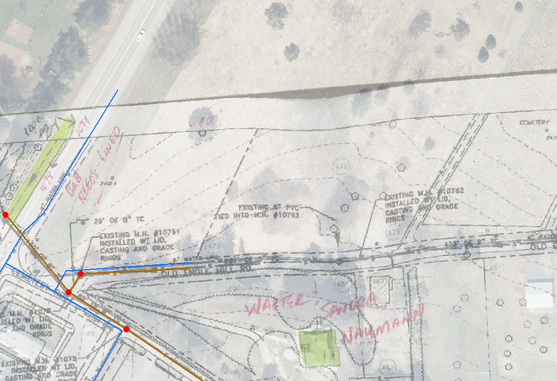
Scanning
Notes:
We had much better results using D-sized (24”x36”) drawings on the large-format scanner than these Tabloid (11”x17”) folded masterpieces but in some cases that was all we could get.
You can see how the warped scan from where I couldn’t quite get the paper mashed down onto the copier’s scanner might affect the accuracy of the water line I was digitizing there.

Slide 11
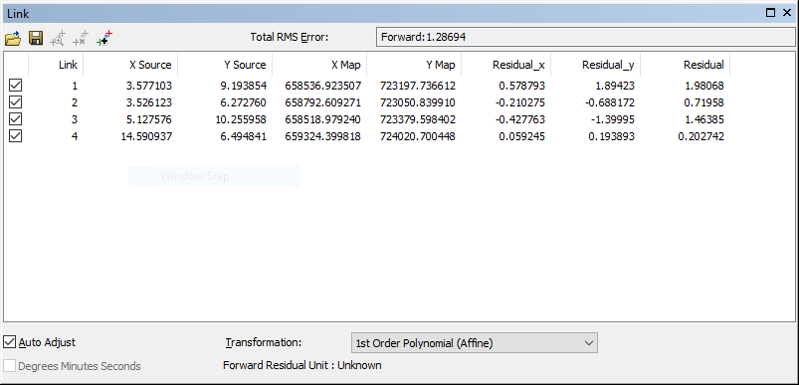
Georeferencing
Notes:
Showing the Link table from the Georeferencing toolbar. The RMS values here were actually pretty good compared to some of the ones I settled for.
I remember and overall RMS of 0.04 being good for using the digitizing tablet.

Slide 12
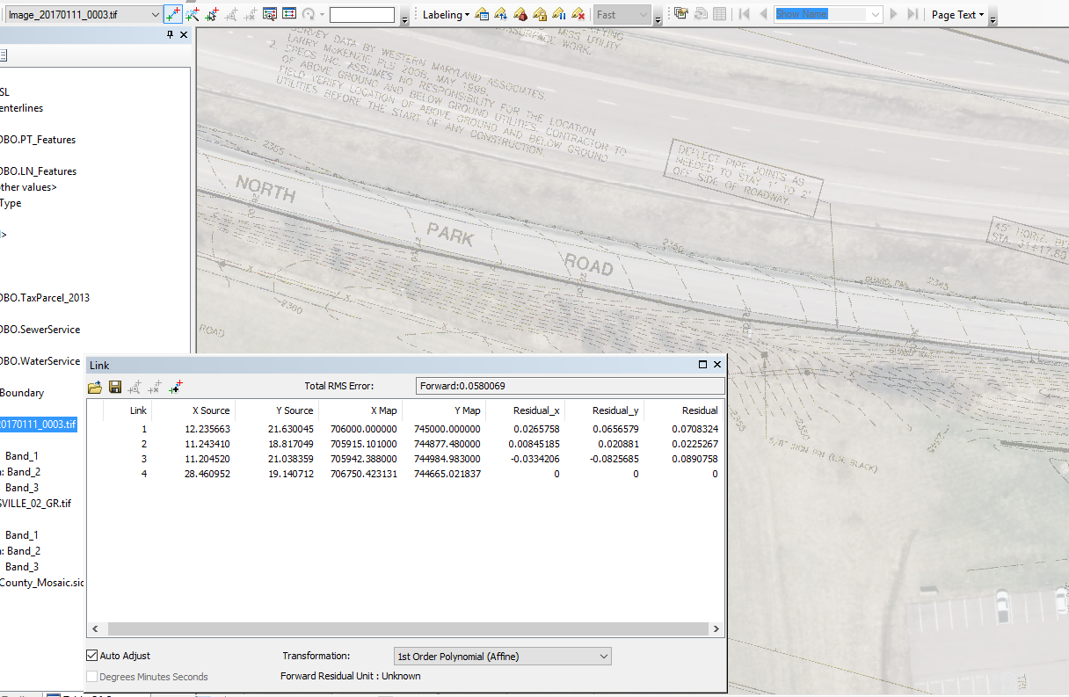
Georeferencing - Transparency
Notes:
Setting the Images to be partly transparent (50% or more) helped me to compare them with the aerial photo (also partly transparent here).
I’m primarily using the 6” 2014 Maryland Imagery as a background.

Slide 13
Digitizing - Overview
Sequence for digitizing is …
1. Georeference the image(s).
2. Digitize the points (usually manholes).
3. Digitize the lines.
4. Reconcile & Post.

Slide 14
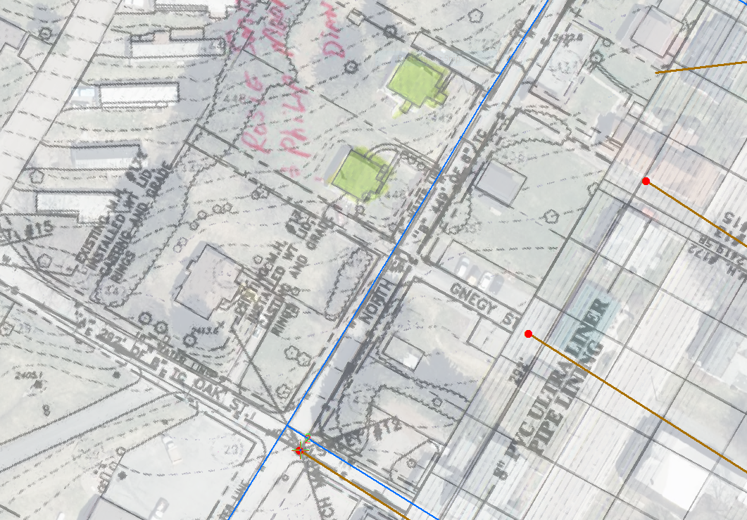
Digitizing
Notes:
Here I’ve got some water lines in blue and sewer lines in brown with manholes (proposed) in red. The one in the intersection reads Existing MH # 17 installed wt. lid, casting, and grade rings. I typically just put all of that excess information into a comment.

Slide 15
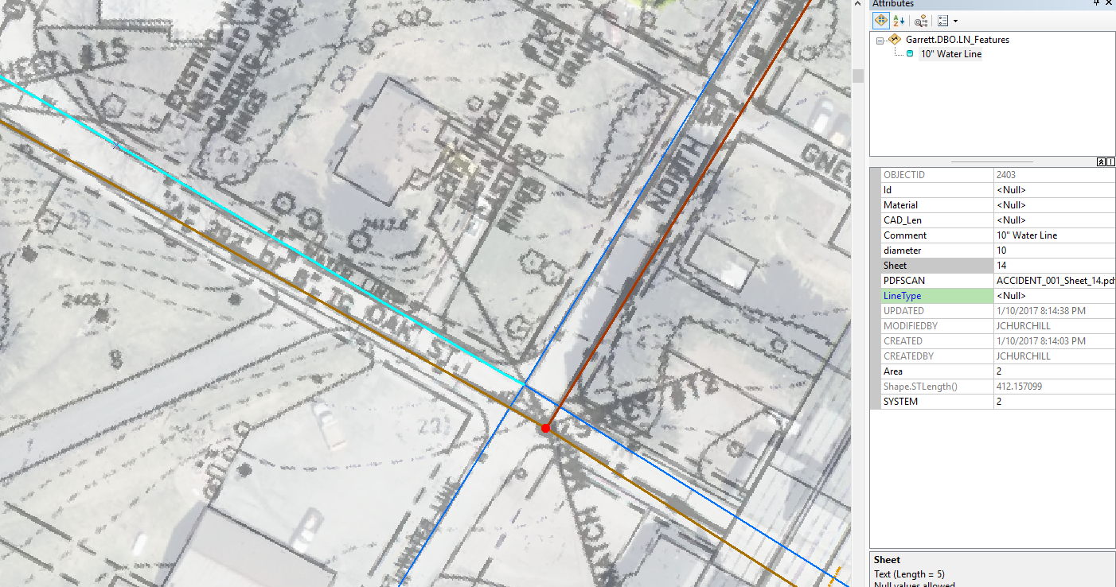
Digitizing – missing data
Notes:
Sometimes you don’t get all of the information from the drawings. For example here I know the selected line feature is a 10” diameter water line but there is no length specified in the drawing and the material is not specified.
The hope is that the information can be filled in by DPU workers with first-hand knowledge in the field.

Slide 16
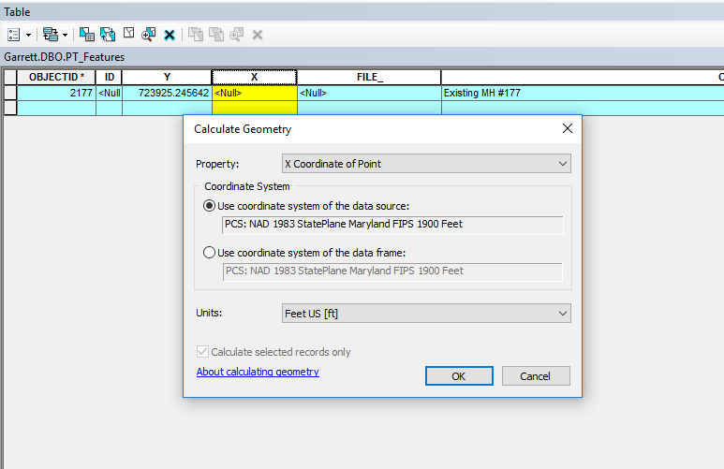
Digitizing – Point coordinates
Notes:
I’ll typically include a field for the State Plane Coordinates and just calculate coordinates for points periodically using Calculate Geometry.
It provides an easy way to look up coordinates for someone working in the field.

Slide 17
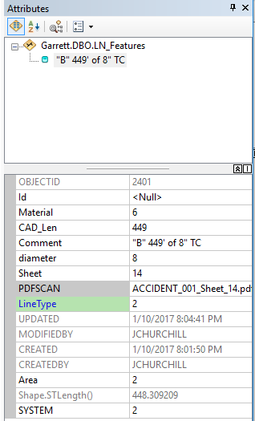
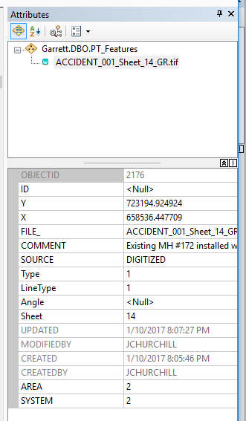
Digitizing - Attributes
Notes:
Just showing some examples of line (left) and point (right) features with attributes pretty well completed.
For the lines I’ve got length, diameter, material (6 is Terra Cotta in the domain). The comment captures all of that. Sheet number and file are all included.
For the points I’ve got coordinates, file name, type (1 is Manhole).
Once we finalize the coded domain values and associate those domains with the feature classes, it will be easier to read these attributes in the table without memorizing them.

Slide 18
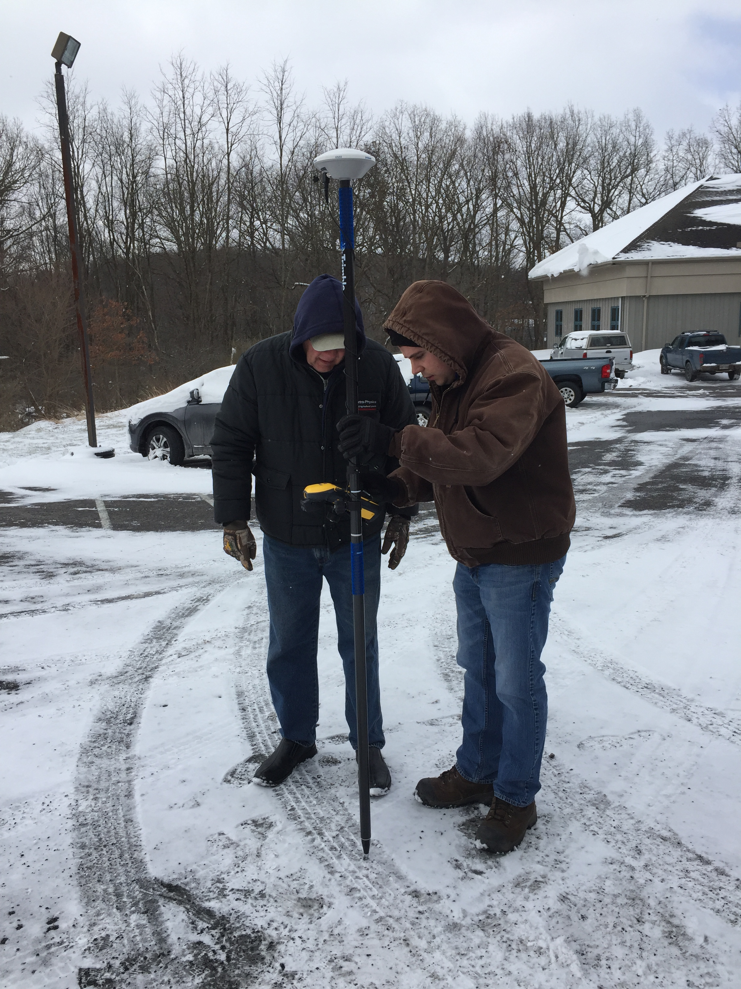
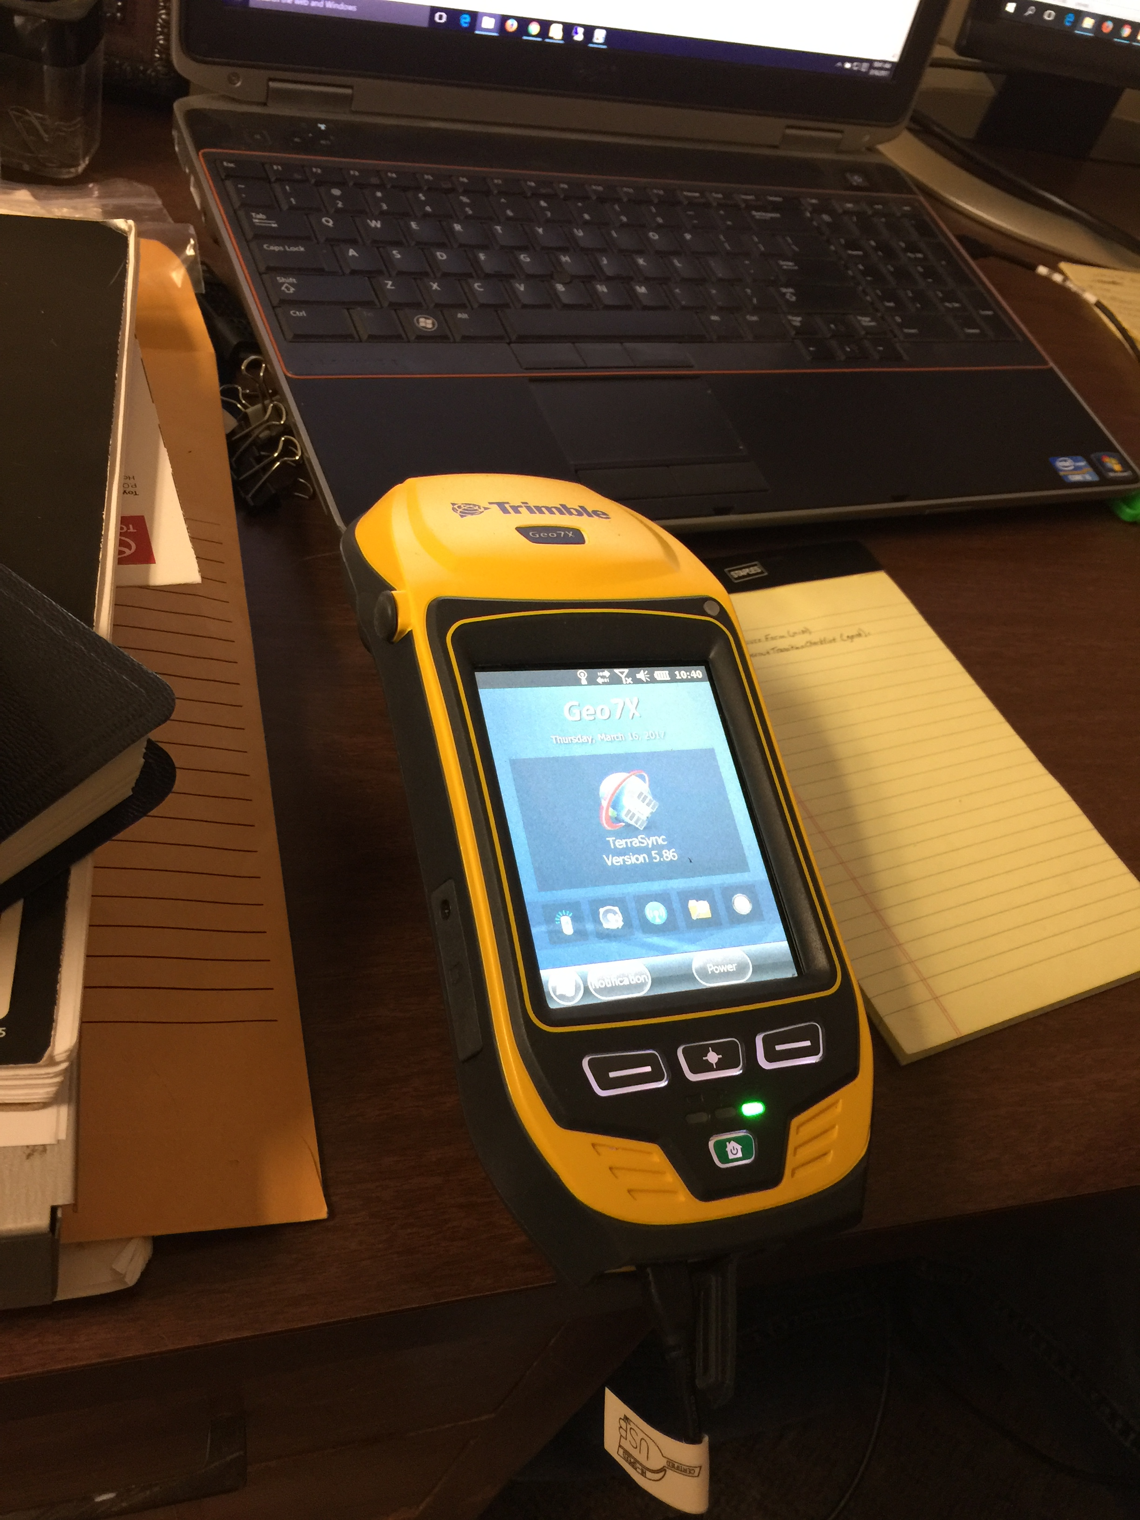
Extensions to the project - GPS
Notes:
The Engineering Department is buying some survey-grade Trimble GPS equipment. We actually just acquired the single unit.
I see this becoming very useful for us if we are able to get lines GPS’d we can conflate the data digitized from drawings and improve the spatial accuracy significantly. There is a Source field that we are using to indicate whether it was “DIGITIZED” or “CONFLATED”.
We are working now on trying to sync the schema I’m using with the water and sewer lines and points with the data dictionary that Engineering and DPU will use for getting locations.

Slide 19
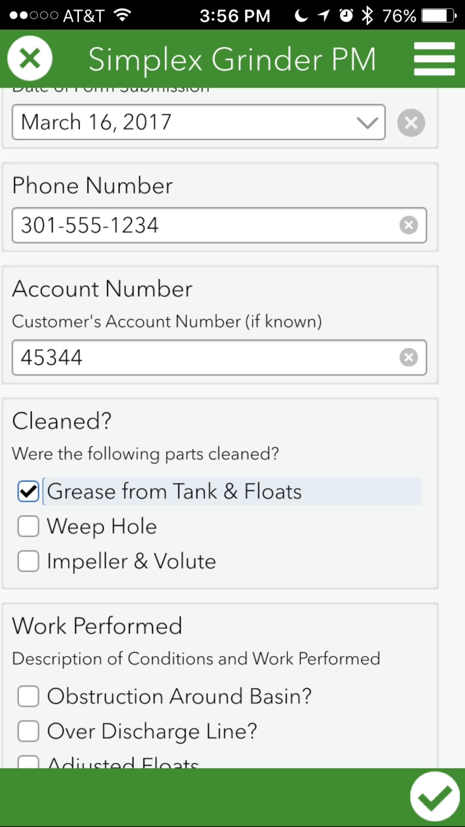
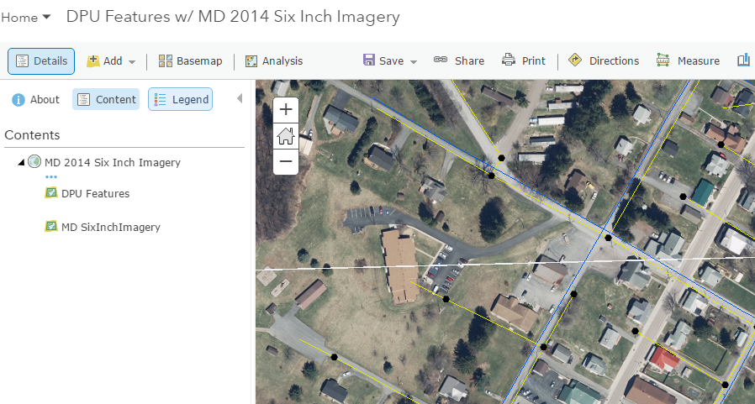
Extensions to the Project – Mobile Apps
Notes:
We are starting to use Survey 123 to collect information that was previously on paper forms. The grinder pump preventative maintenance survey has some potential to get used. I’m still working with them on optimizing ways of collecting the data and including it in our GIS as the surveys are improved. I talked directly to the field crew on Friday to walk them through the process of downloading a new improved version of the Grinder PM survey.
We have some ArcGIS Services and AGOL maps. I have the service features embedded in the basemap here for the survey locations but they are often more useful when separated out (so the popup can be configured)

Slide 20
Advice
Work with support staff and “Plan Ahead”.
Know but be willing to challenge "conventional wisdom". Your needs are those of your organization and its GIS users.
Having something is “better than nothing”.
Notes:
Support Staff – I didn’t really want to put ESRI in the bullet point but our Local Govt. Account Manager Andrew Falker and his colleague (Solutions Engineer Alex Brown) have provided very useful guidance throughout the process. Also talking a lot with the DPU helped.
Use this to talk about recommendations of adopting existing templates and schemas.
I hate to put it in these terms. How do you feel about the data … “Its better than nothing”. It serves as a baseline, a starting point and WILL get better.

Slide 21
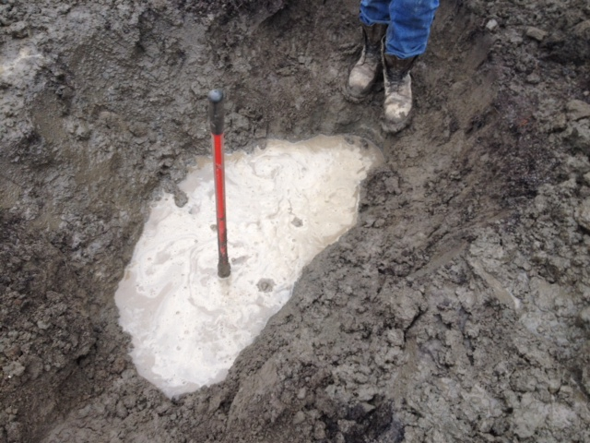
The End!
Questions?
Notes:
That’s where it ends?
Does anyone have any questions?

